Slide 1


Unit 2: Lesson 8 How embarrassing!
U ovoj ćemo lekciji:
uspoređivati past simple i past continuous
čitati i slušati priče o neugodnim situacijama
opisati neugodnu situaciju
govoriti o tome kako se nositi sa stresom

Slide 2


Slide 3
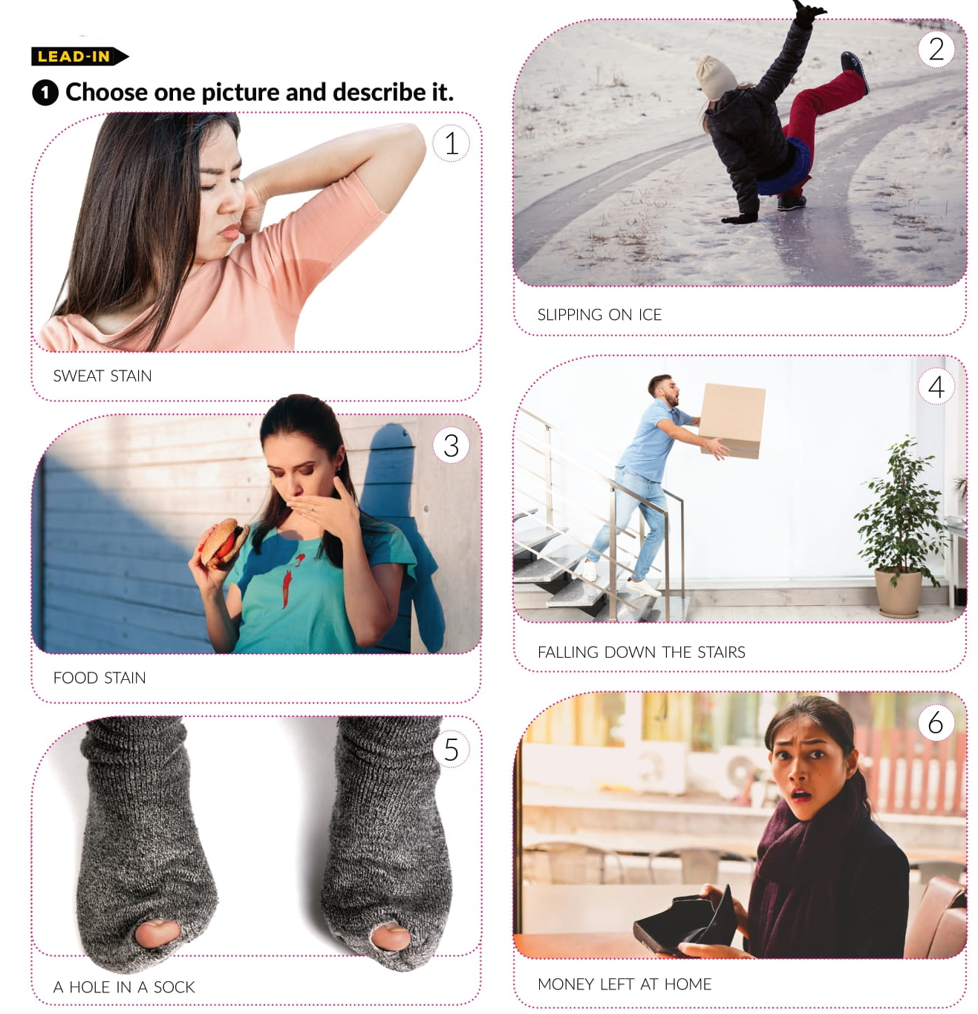

Open your book on page 46.

Slide 4
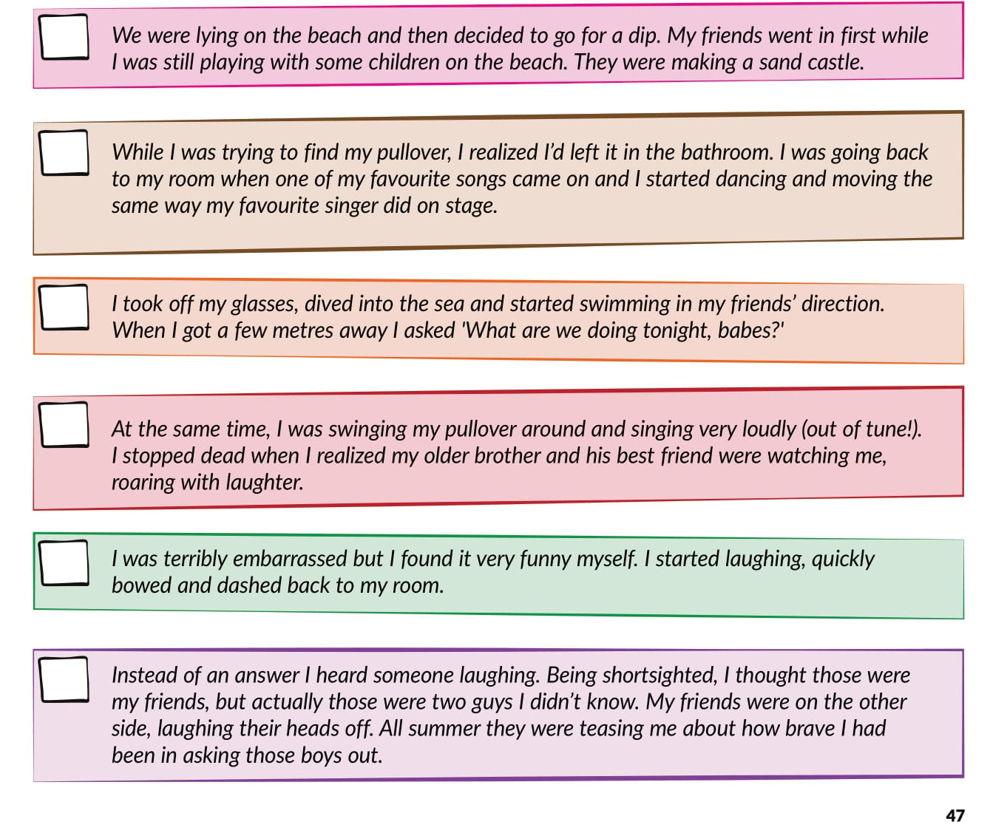
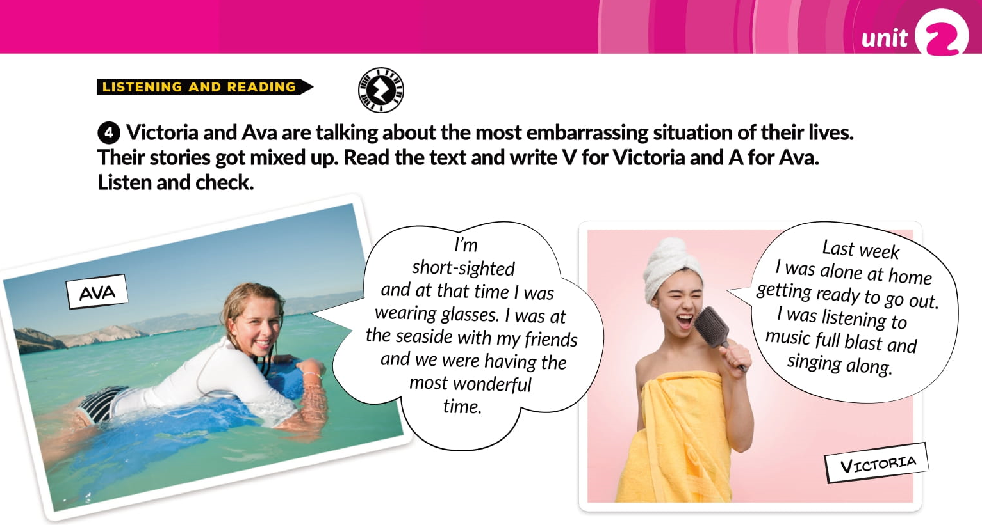
A
V
A
V
V
A

Slide 5
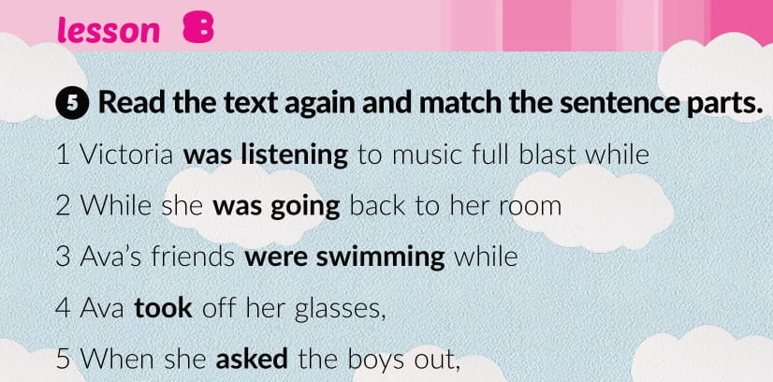
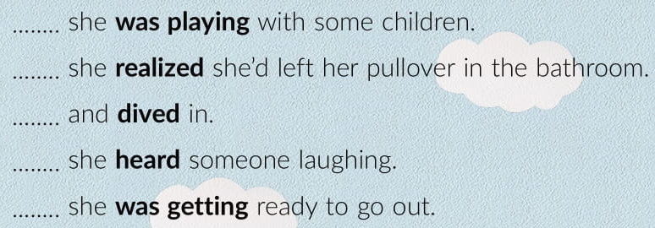

3
2
4
5
1

Slide 6
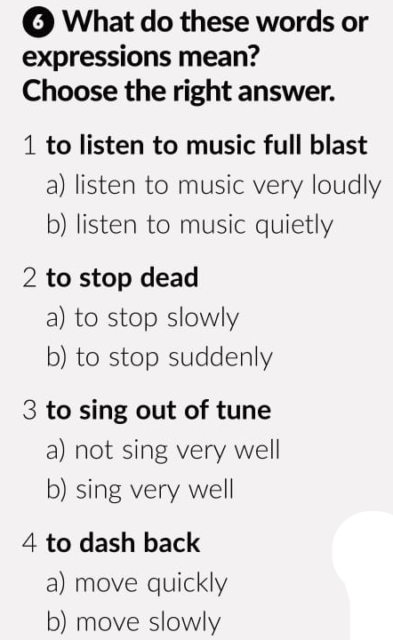
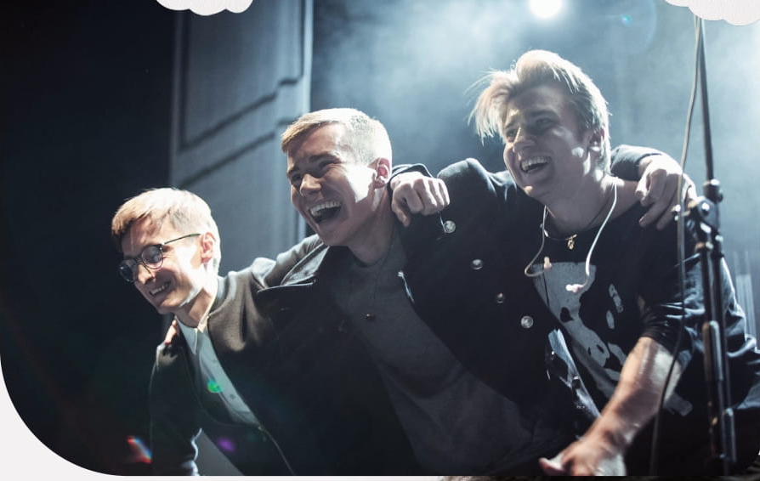
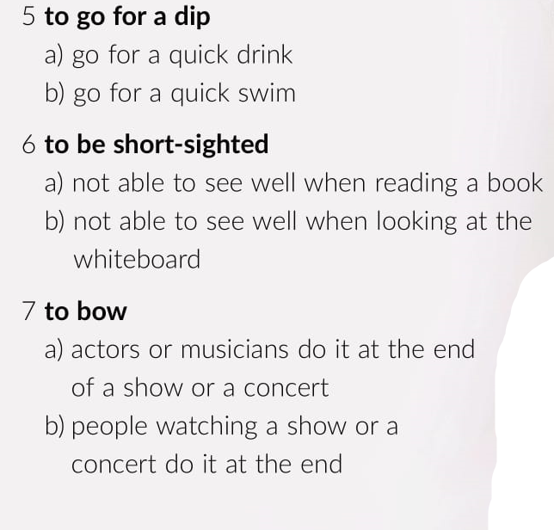
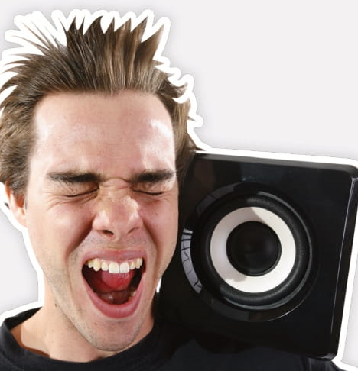

Slide 7

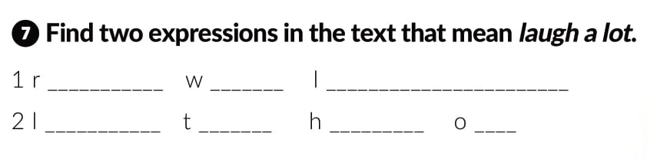
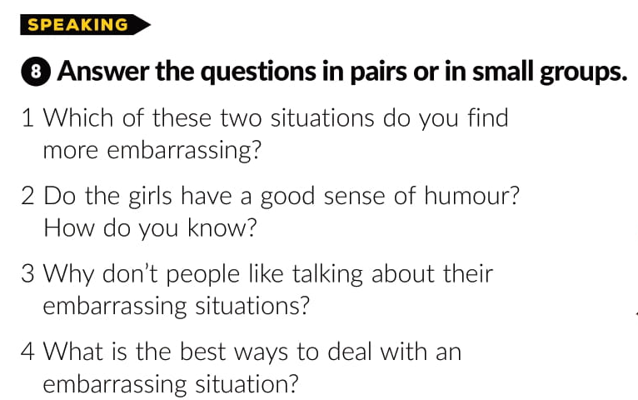
oar ith aughter
augh he ead ff

Slide 8
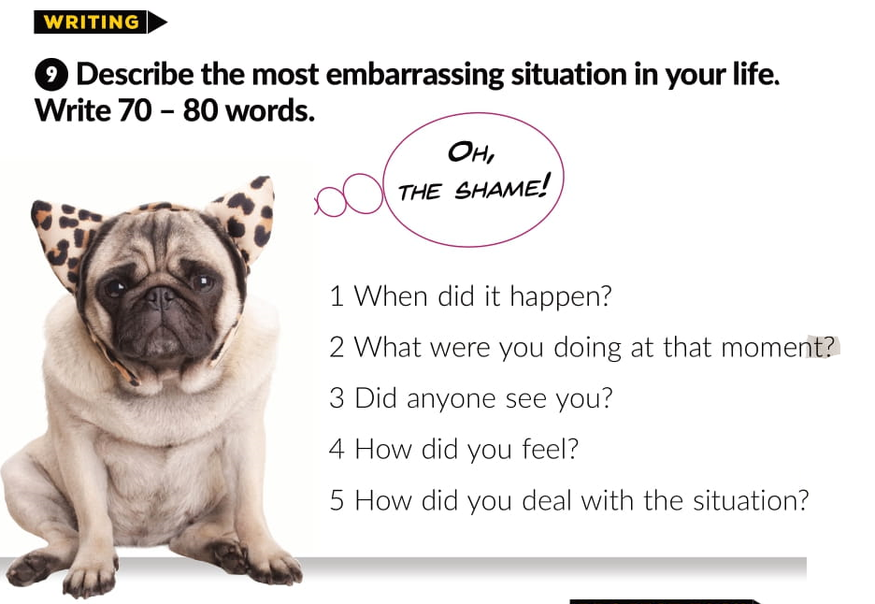

Slide 9
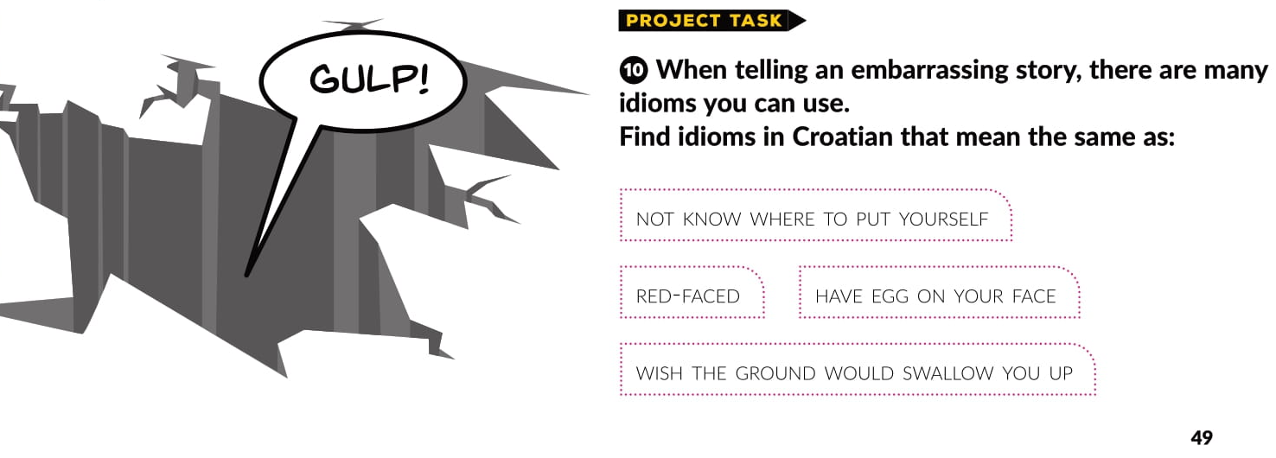
NE ZNATI KAMO SE OKRENUTI
CRVEN KAO PAPRIKA
KOJA SRAMOTA!
ZEMLJO, OTVORI SE!

Slide 10
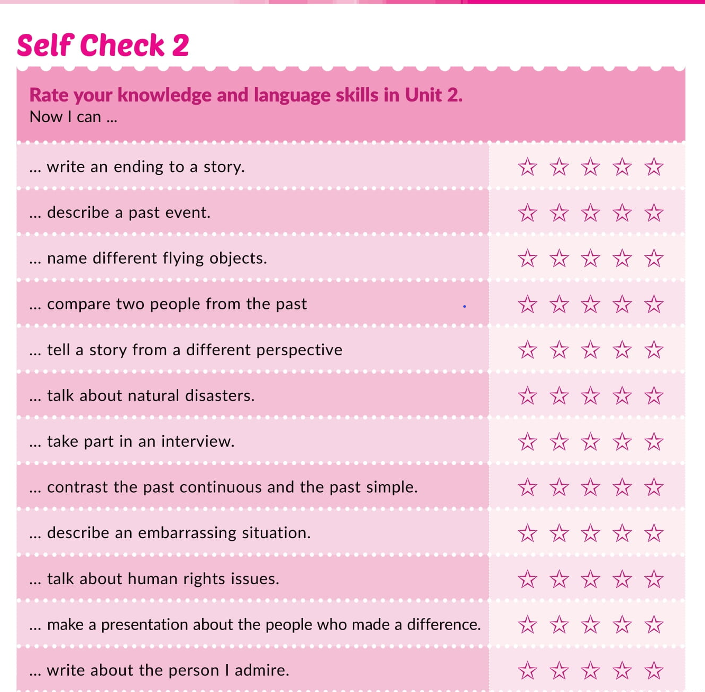

Slide 11
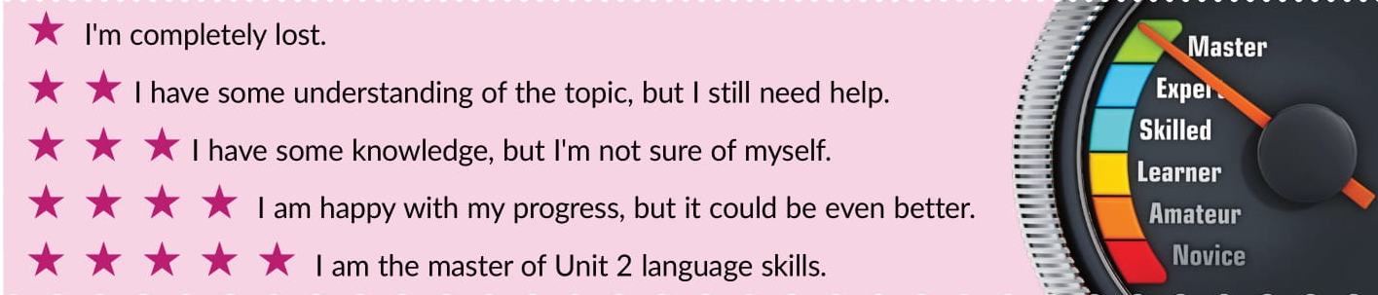
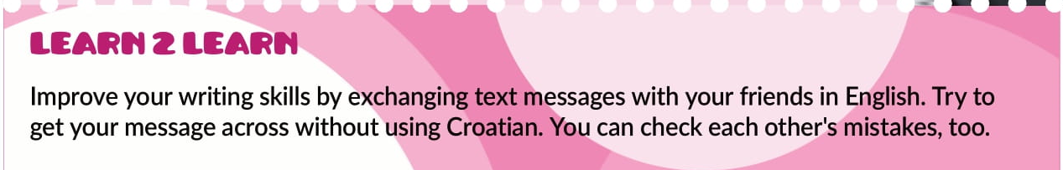

Slide 12
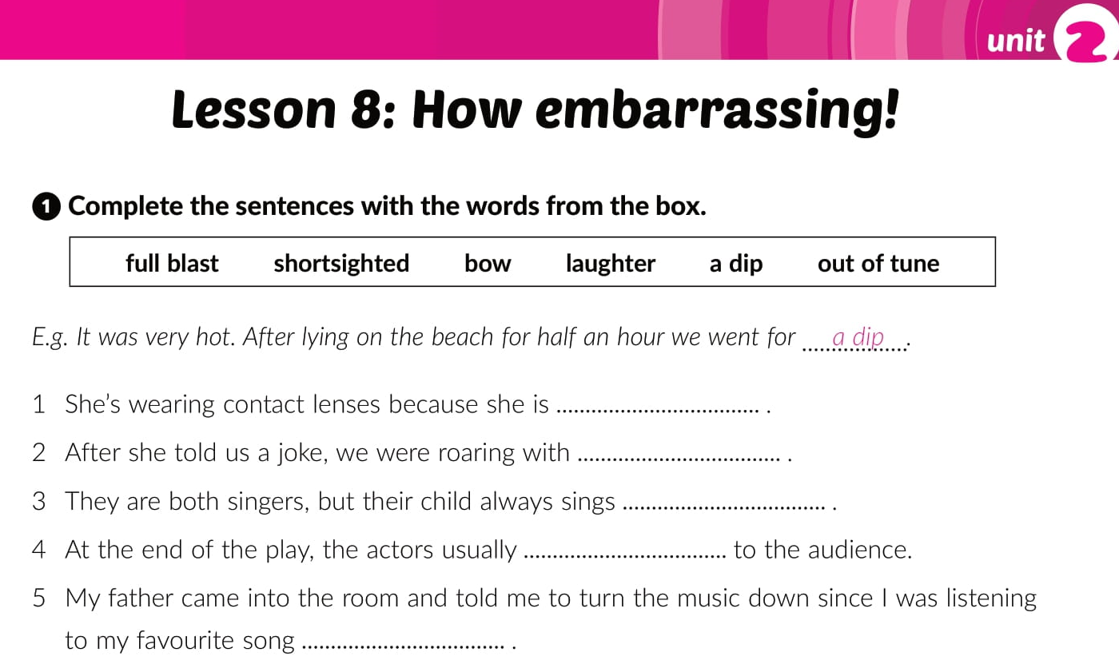
Open your workbook on page 31.
shortsighted
laughter
out of tune
bowed
full blast

Slide 13
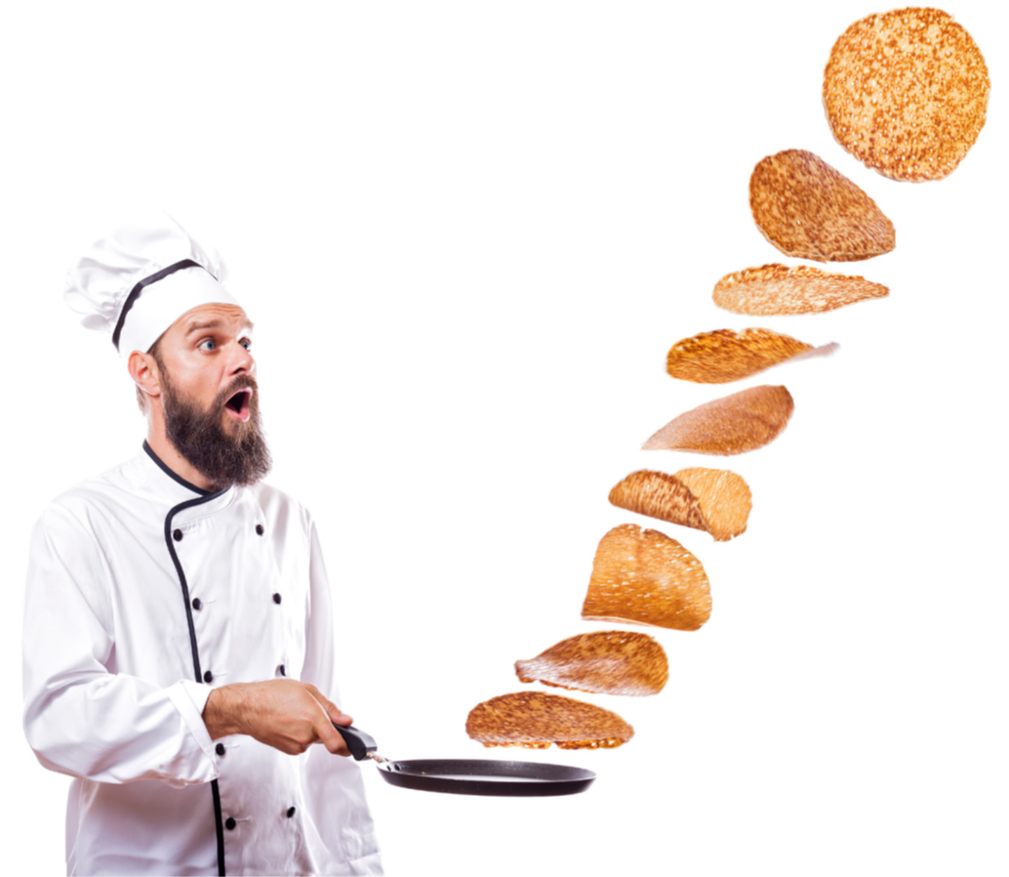
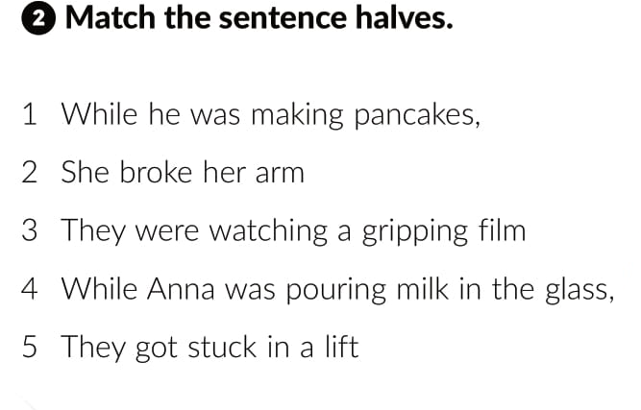
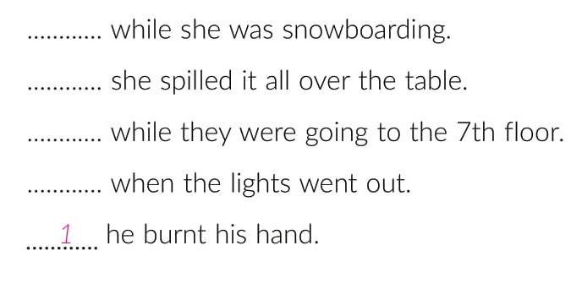
2
4
5
3

Slide 14
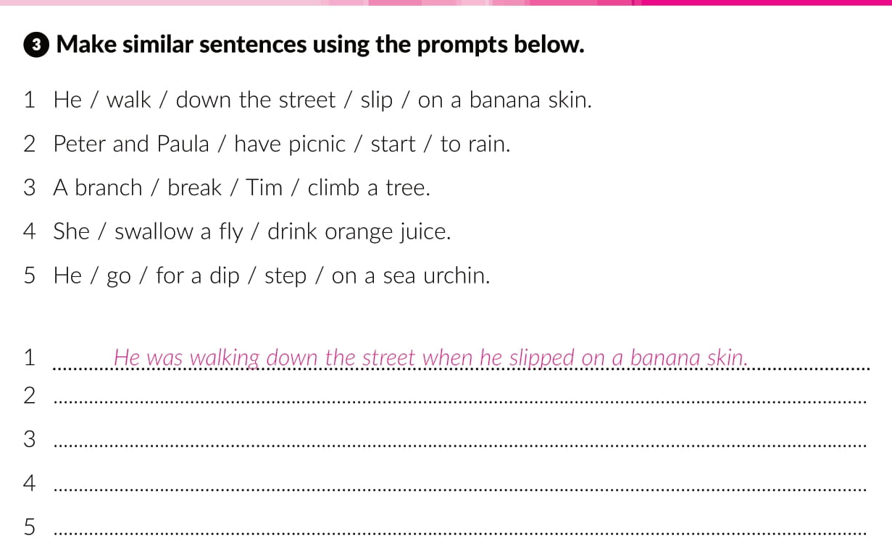
Peter and Paula were having a picnic when it started to rain.
A branch broke while Tim was climbing a tree.
She swallowed a fly while she was drinking orange juice.
He was going for a dip when he stepped on a sea urchin.

Slide 15
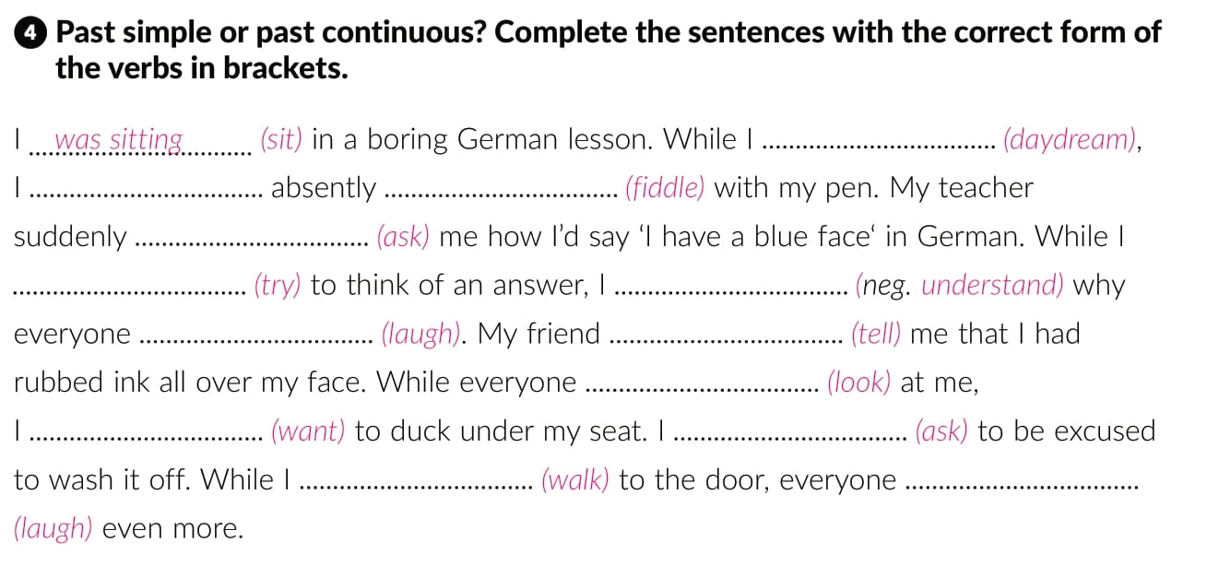
was daydreaming
was
fiddling
asked
was trying
did not understand
was laughing
told
was looking
wanted
asked
was walking
was laughing

Slide 16
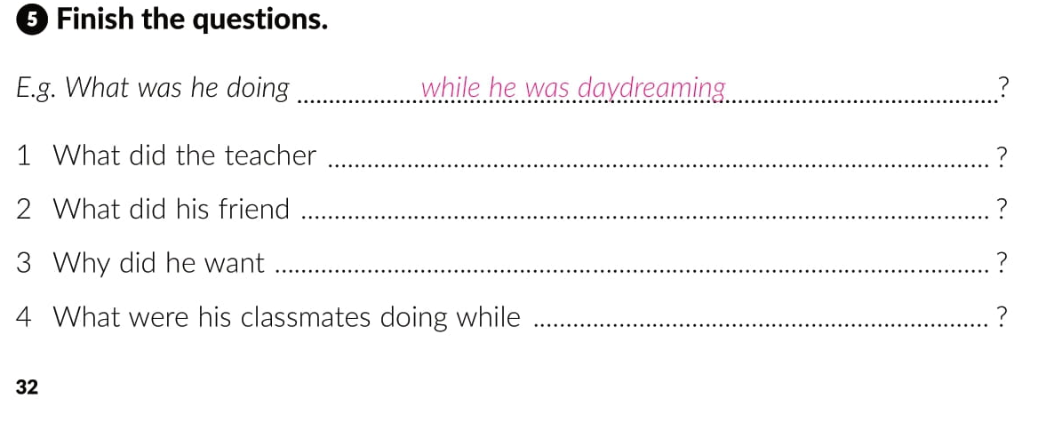
ask him while he was fiddling with his pen
tell him while he was trying to think of an answer
to duck under his seat while everyone was looking at him
he was walking to the door

Slide 17
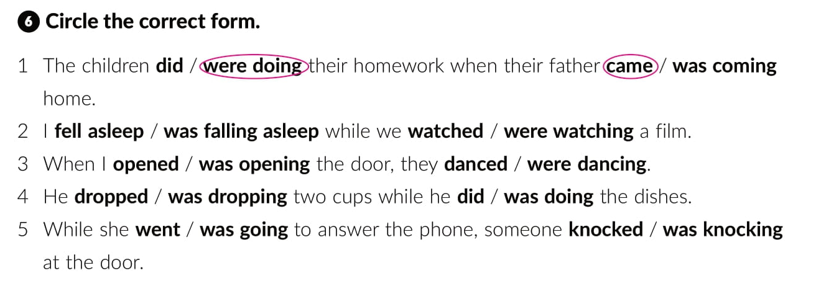

Slide 18
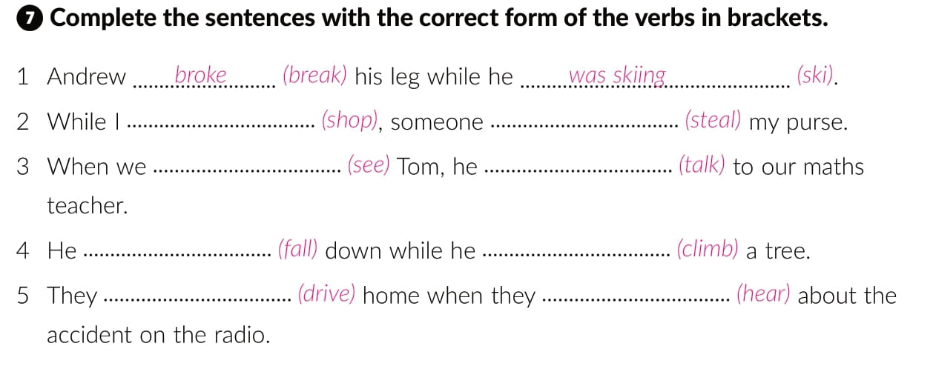
was shopping
stole
saw
was talking
fell
was climbing
were driving
heard

Slide 19
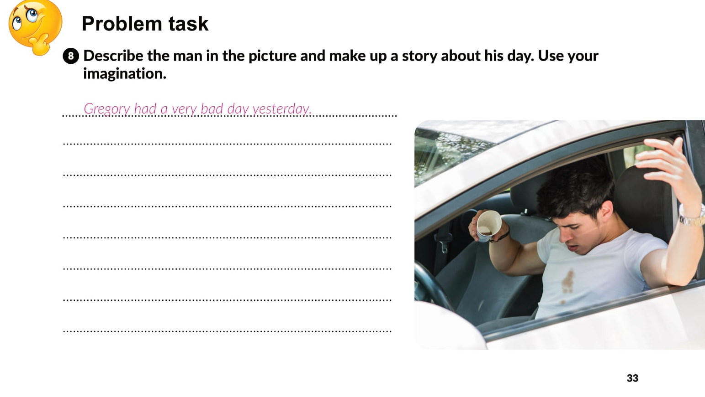

Slide 20
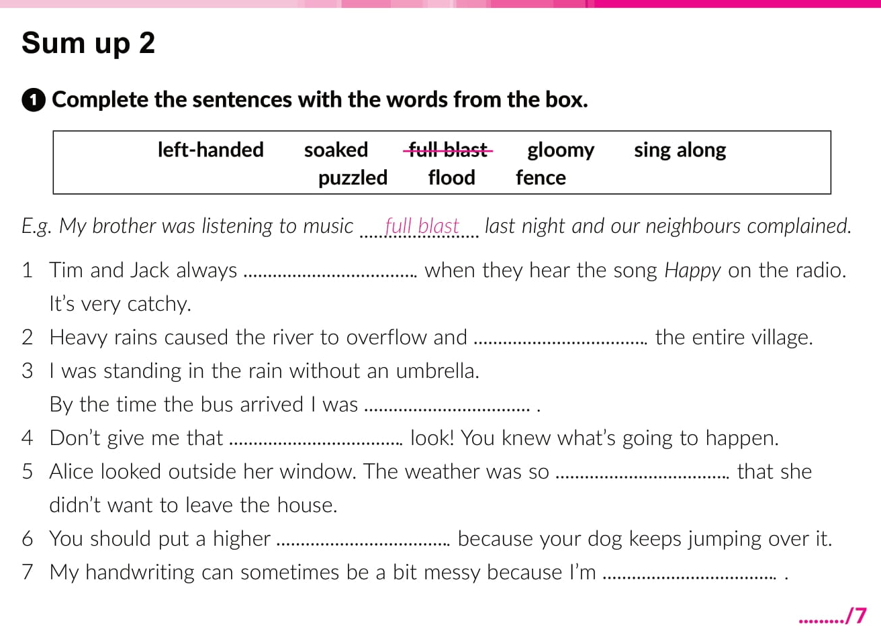
sing along
flooded
soaked
puzzled
gloomy
fence
left-handed

Slide 21
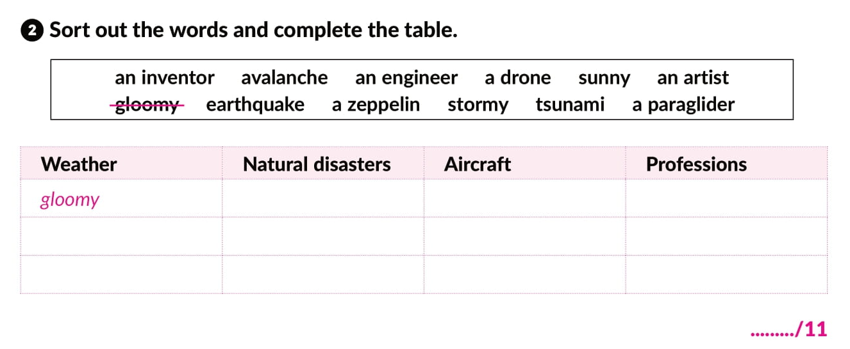
avalanche
a drone
an inventor
sunny
earthquake
a zeppelin
an egineer
stormy
tsunami
a paraglider
an artist

Slide 22
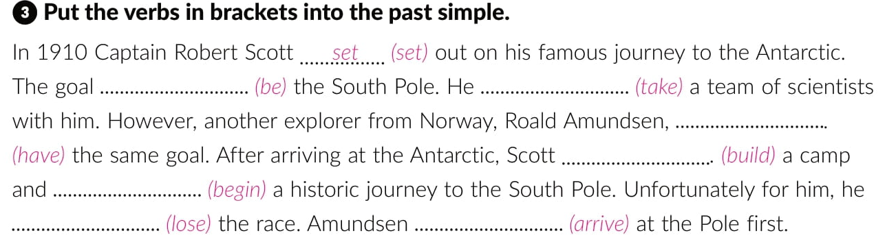
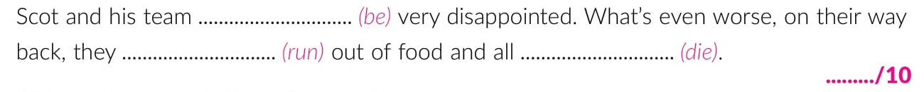
was
took
had
built
began
lost
arrived
were
ran
died

Slide 23
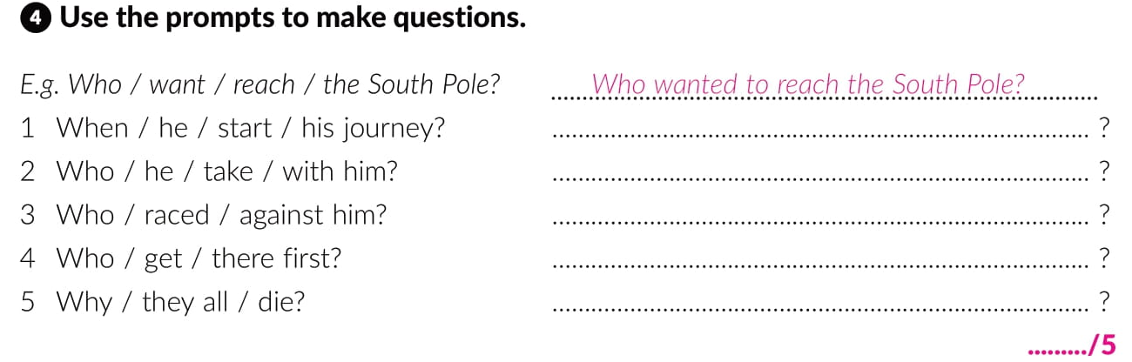
When did he start his journey
Who did he take with him
Who raced against him
Who got there first
Why did they all die

Slide 24
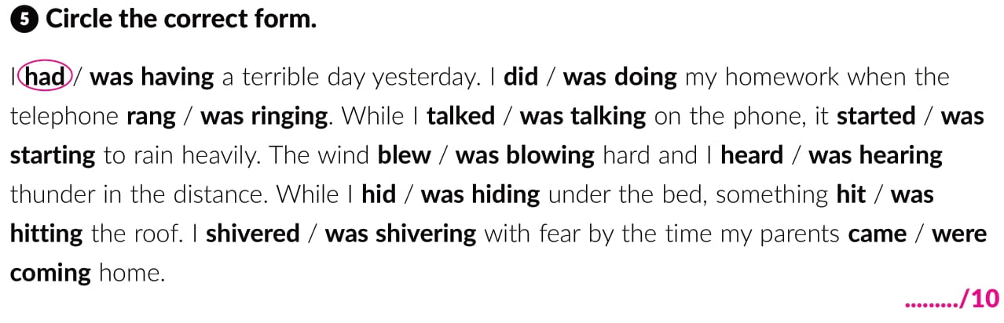

Slide 25
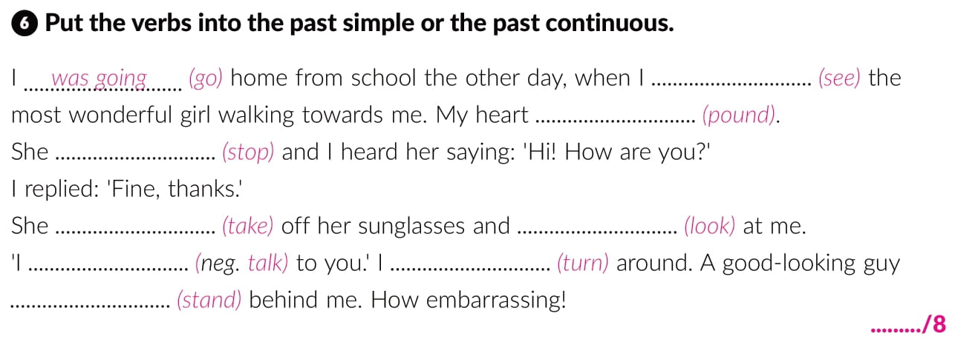
saw
was pounding
stopped
took
looked
didn’t talk
turned
was standing

Slide 26
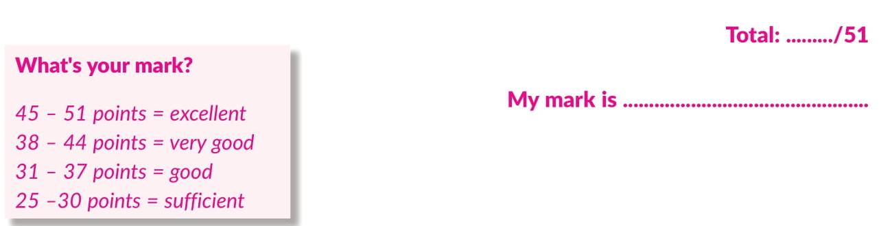

Slide 27
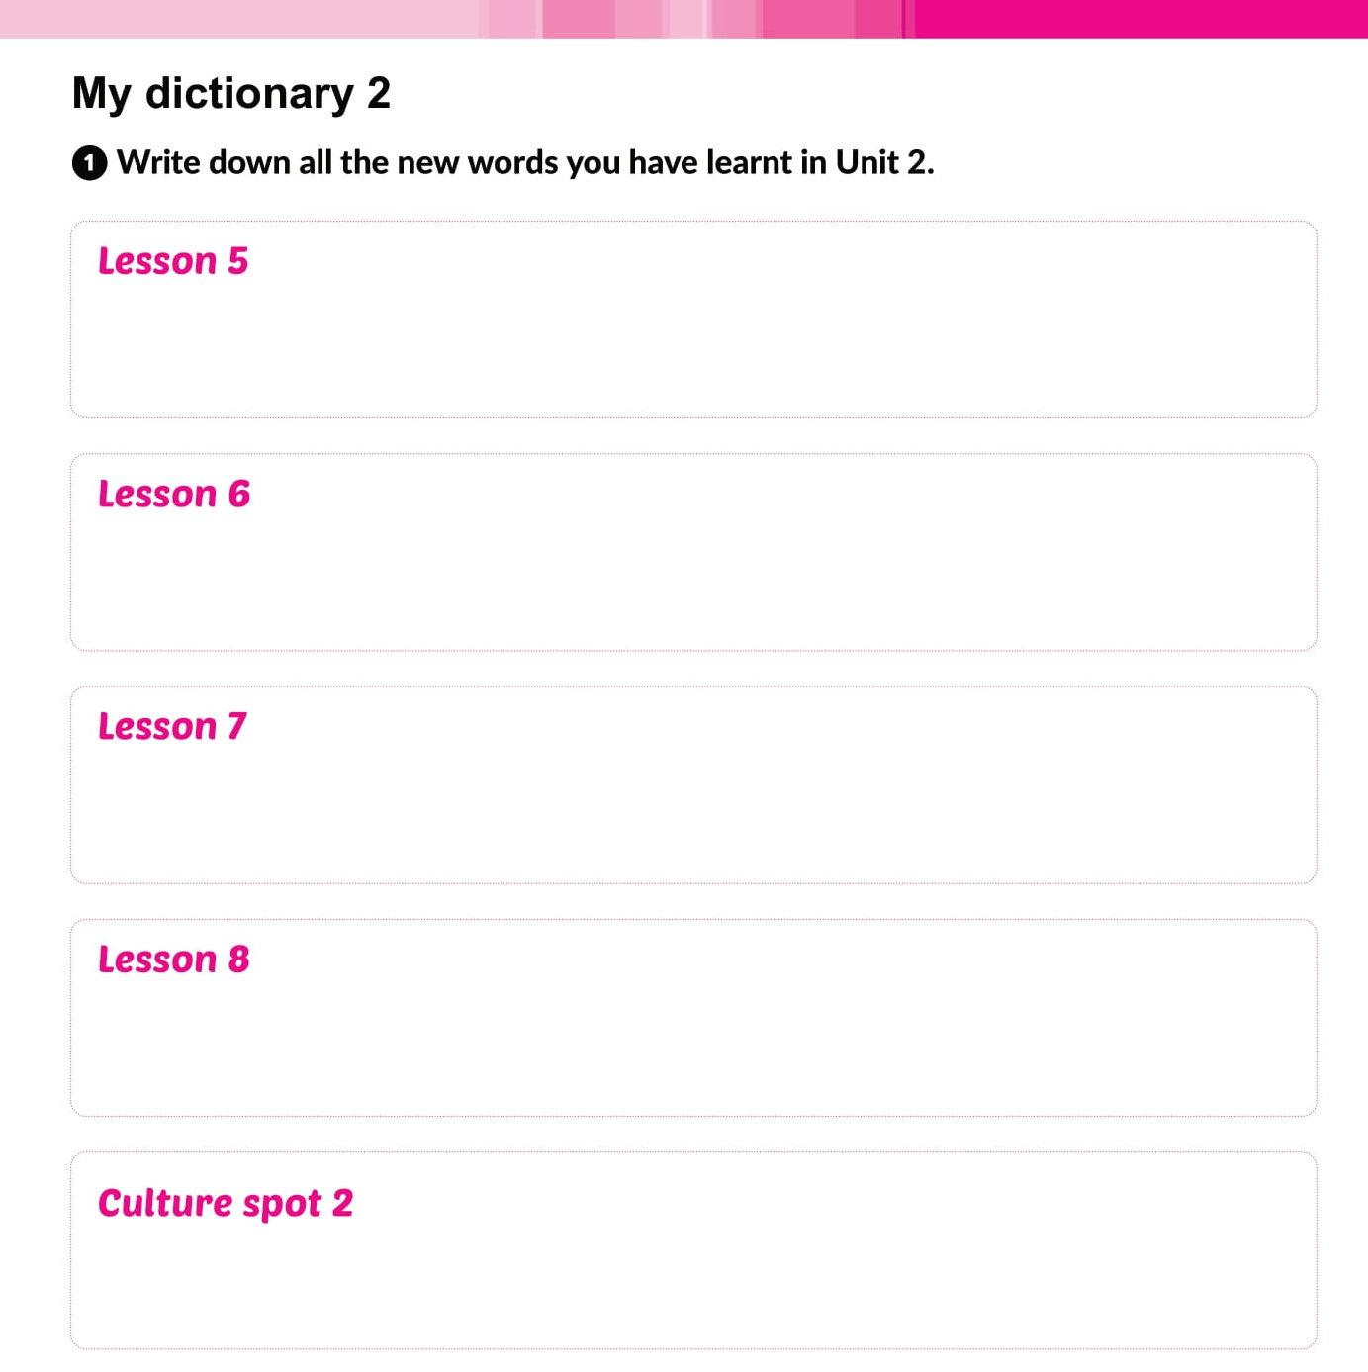
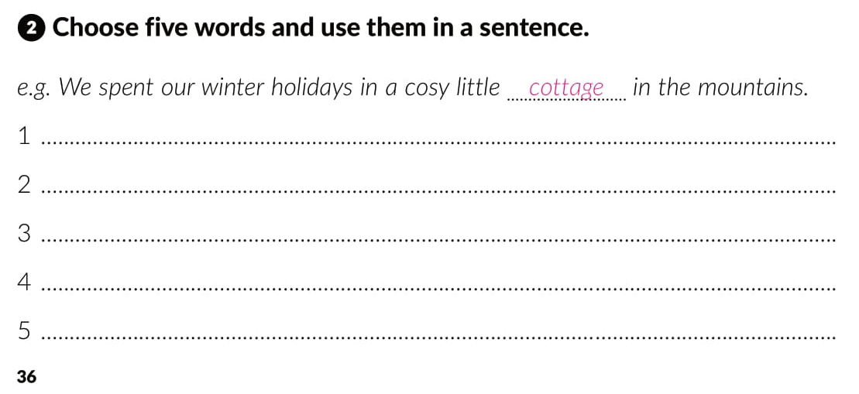

Slide 28

Otvori sljedeću poveznicu, te odaberi PLAY AND LEARN!
Lesson 8 How embarrasing | Way to go 4 (e-sfera.hr)

